Slide 1

HELLO!
Here 1Crore Projects
I am here because I love to give presentations.
You can find me at @1CROREPROJECTS

Slide 2
A Practical Attribute-Based DocumentCollection Hierarchical Encryption Scheme in Cloud Computing

Slide 3

AIM OF PROJECT
The main aim of the project is ciphertext-policy attribute-based encryption can provide fifine-grained access control and secure data sharing to the data users in cloud computing.

Slide 4
ABSTRACT
In current day’s secure document storage and retrieval is one of the hottest research directions in cloudcomputing. Although many searchable encryption schemes have been proposed, few of them support efficientretrieval over the documents which are encrypted based on their attributes.In this paper, we propose a practicalCiphertext-Policy Attribute-Based Hierarchical document collection Encryption scheme named CP-ABHE. Ingeneral we can clearly identify that CP-ABHE is more efficient in both computation and storage space withoutsacrificing data security. In CP-ABHE, we first construct a set of integrated access trees based on thedocuments' attribute sets. We employ the greedy strategy to build the trees incrementally and grow the treesdynamically by combining the small ones.

Slide 5
INTRODUCTION
Cloud computing, a rising innovation was first proposed in Quite a while 2006(Search Engine Strategies2006) by San Jose and characterized by NIST(National Institute of Standards and Technology).Since it wasproposed distributed computing has pulled in more noteworthy consideration from various areas of society.Distributed computing can gather and rearrange an enormous measure of information and obviously, the cloudworkers can give safer and adaptable, monetary and customized administrations contrasted and theneighborhood workers. As cloud administrations have gotten more well-known, requests for figuringinformation in the cloud have expanded. Regardless of the benefits of cloud administrations, releasing the
delicate data,

Slide 6
EXISTING SYSTEM
The term “attribute-based encryption” (ABE) in the field of information security.
Many ABE schemes are designed including KP-ABE schemes and CP-ABE schemes. Though KP-ABE can provide fine-grained access control, it restricts its attention to the monotone access structure only.
A KP-ABE scheme which allows a user’s private key can be expressed in terms of any access formula over attributes. Further, they prove the scheme’s security based on decisional bilinear Diffie-Hellman assumption.

Slide 7
DISADVANTAGES
The KP-ABE scheme performs better than CP-ABE in terms of encryption/decryption efficiency and the size of CT. However, KPABE scheme is the secret key expanding problem.

Slide 8
PROPOSED SYSTEM
Data owner is responsible for collecting documents and assigning a proper attribute set to each document. The documents are encrypted in two phases.
Each document is first encrypted by a symmetric encryption algorithm with a unique content key. Then, the content keys are encrypted by ABE-schemes. At last, both the encrypted documents and content keys are outsourced to the cloud server.

Slide 9
ADVANTAGES
More and More enterprise and individual users’ trend to outsource the local documents to the cloud.
The security of CP-ABHE is theoretically proved and the effectiveness of the integrated access tree construction algorithm is analyses.
The encryption/decryption efficiency. Moreover, the secret key expanding problem is solved properly.

Slide 10
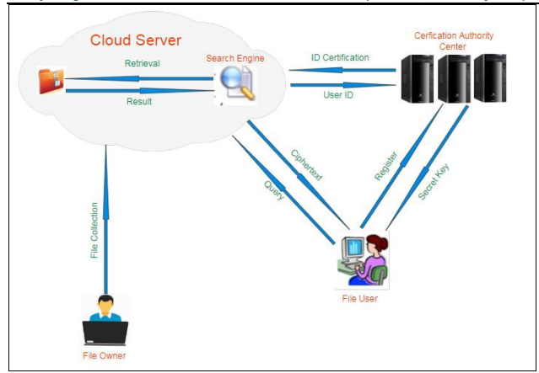
SYSTEM ARCHITECTURE

Slide 11
MODULES
In this project having two modules:
Data owner
Data users
CA
Attacker
Cloud

Slide 12
DATA OWNER
Register
User have to register our details with bio-metric (fingerprint) technique.
Login
In owner login module have 3-steps verfications
only authorized users can able to login our account.
Upload File
Auditing Files
Logout

Slide 13
DATA USER
Register
Login
Search
Download Request
using file private key user can download the files in decrypted format.
Logout

Slide 14
CENTER AUTHORITY
Login
send key to the users
sends the file private key to user's registered mail id.
forward auditing request to cloud server
Logout

Slide 15
ATTACKER
Login
Attack Files
attack the files uploaded by the data owner.
Logout

Slide 16
cloud server
Login
Authorized data owner and user
View Auditing Request
View Attacked Files
View all uploaded Files and view all registered owners and users.
Result
Logout

Slide 17
SOFTWARE REQUIREMENTS
Front End Language | HTML, CSS, JAVA, JSP SERVELTS
Backend | My SQL
Operating System | Windows 10 or 11
IDE | JAVADEVELOPEMENTKIT

Slide 18
HARDWARE REQUIREMENTS
System | Intel i3 and above
Hard Disk | 100GB
RAM | Minimum 4GB
Processor | 64-bit, four-core, 2.5 GHz minimum per core

Slide 19
FUTURE WORK
In our future experiments on our proposedmethod we finally came to an conclusion that CP-ABHE algorithm is best suited to provide security for the
sensitive data to access from the cloud server.

Slide 20
CONCLUSION
In this paper, we design a hierarchical document collection
encryption scheme. We first design an incremental algorithm
to construct the integrated access trees of the documents and
decrease the number of trees. Then, each integrated access
tree is encrypted together and the documents in a tree can
be decrypted at a time.

Slide 21
REFERENCE
[1] J. Bethencourt, A. Sahai, B. Waters, “Ciphertext-policy attribute-based
encryption, Security and Privacy,” IEEE Symposium on. IEEE, 2007: 321-
334.
[2] D. Boneh, B. Waters, “Conjunctive, subset, and range queries on encrypted
data,” in Proc. of TCC, 2007, pp. 535-554.
[3] N. Cao, C. Wang, M. Li, K. Ren, and W. Lou, “Privacy-preserving multi_x0002_keyword ranked search over encrypted cloud data,” IEEE Trans. Parallel
Distrib. Syst., vol. 25, no. 1, pp. 222-233, Jan. 2014.

Slide 22
THANKS!
Any questions?
You can find me at
Reach us – 1croreprojects@gmail.com
Contact / Whatsapp: 7708 150 152 / 9751 800 789 / 790 432 0834

